Slide 1

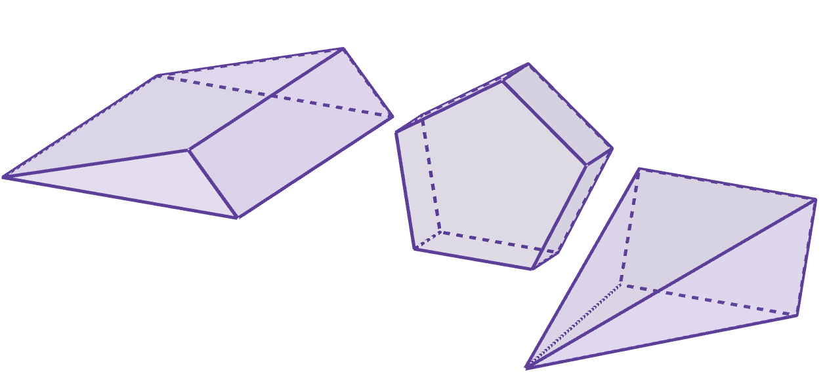
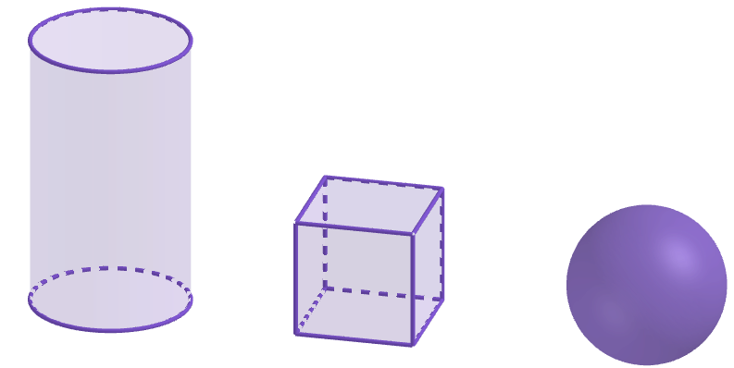
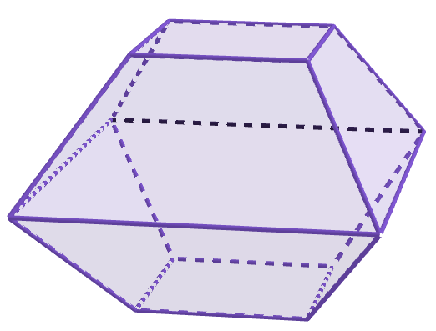
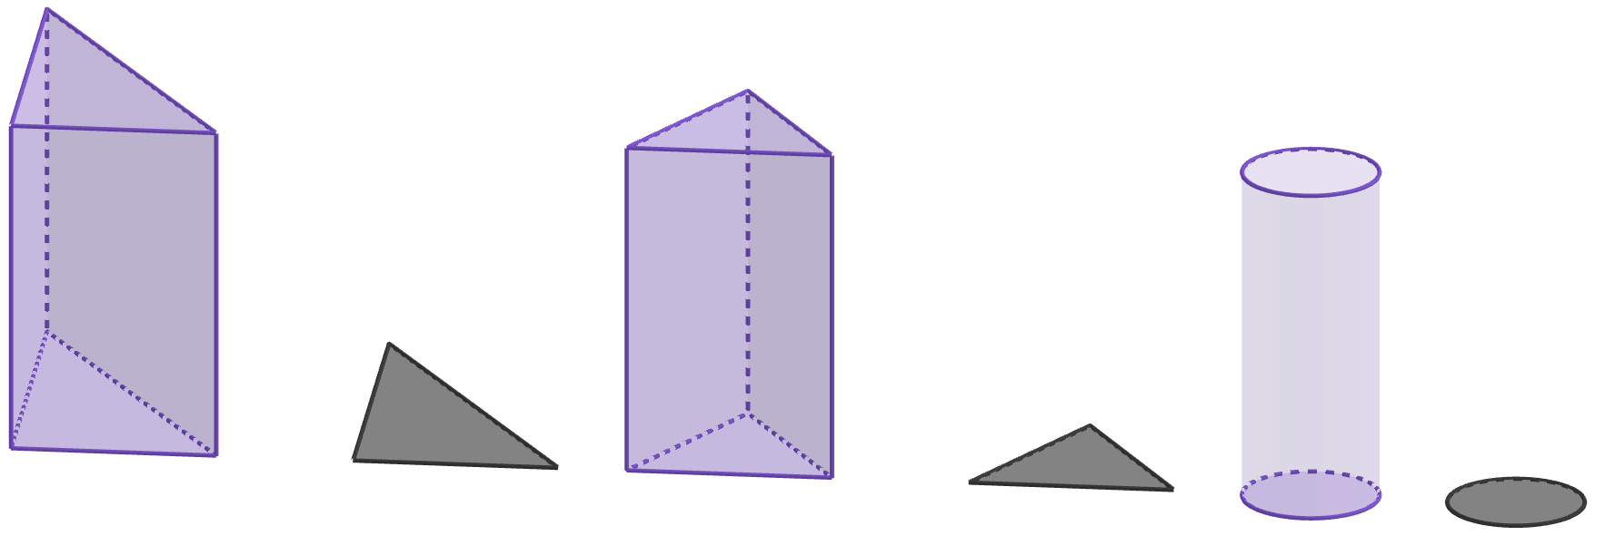
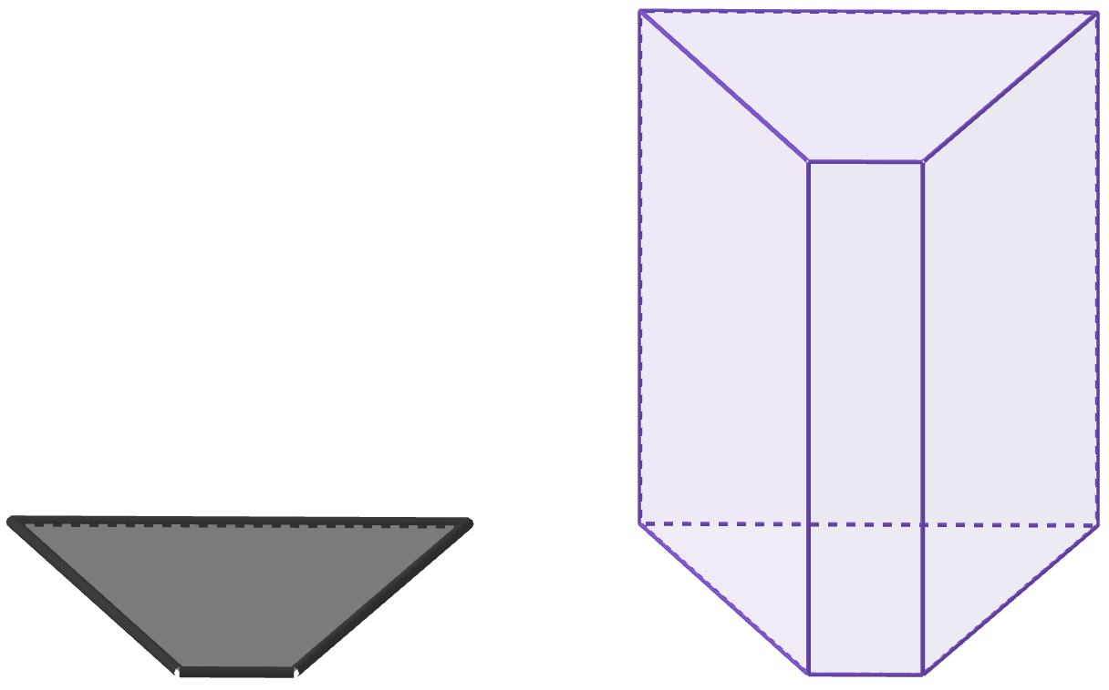
Properties of prisms
Task A: Defining a prism
1) Which of these match the properties of a prism?
a
b
e
f
c
d
g
2) Complete the sentences with the missing words provided to give an explanation of what a prism is.
A prism is a object.
All of its 2D cross sections must be .
In at least one direction, all cross sections must
be to each other.
2D
circular
parallel
congruent
3D
polygons
perpendicular
equidistant
3) These diagrams all show the same prism.
Which of the diagrams show the correct cross sections that help demonstrate it is a pris?. Explain how you know.
a
b
c

Slide 2
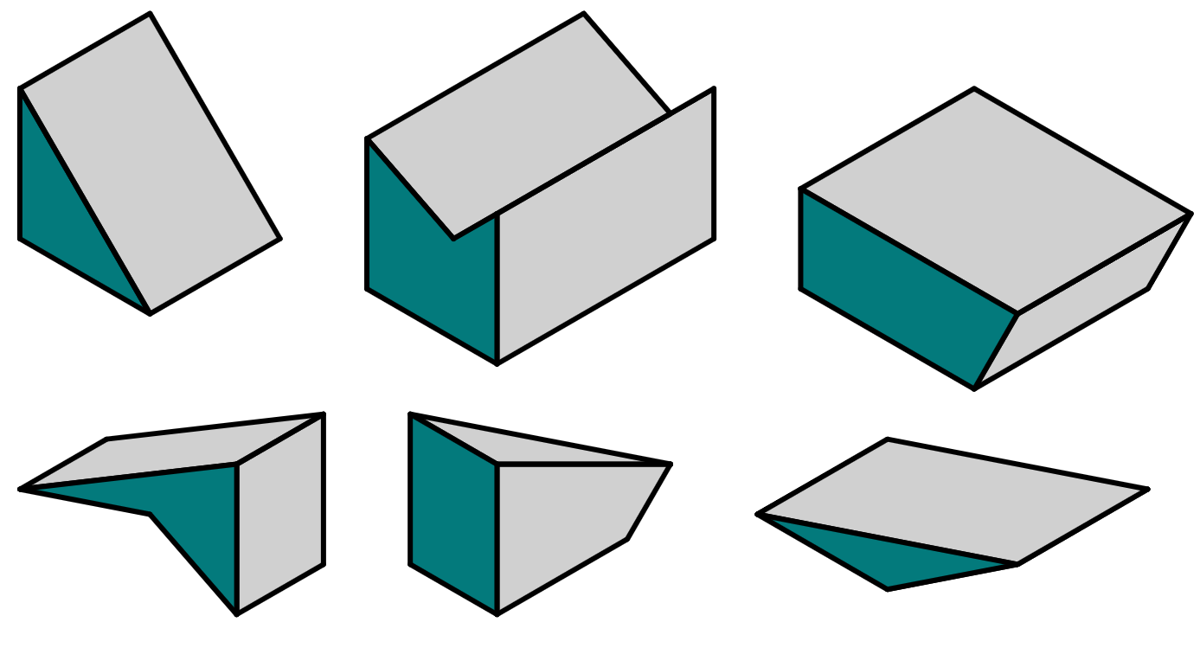
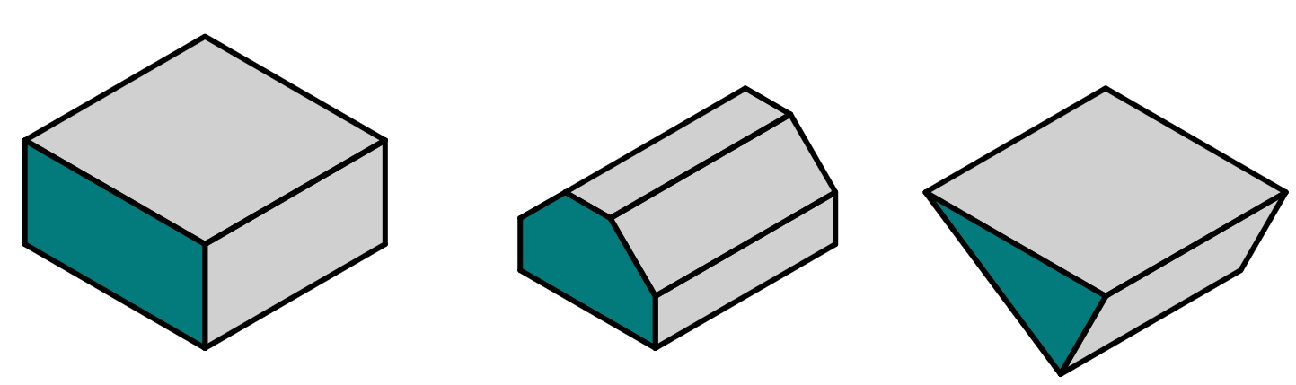
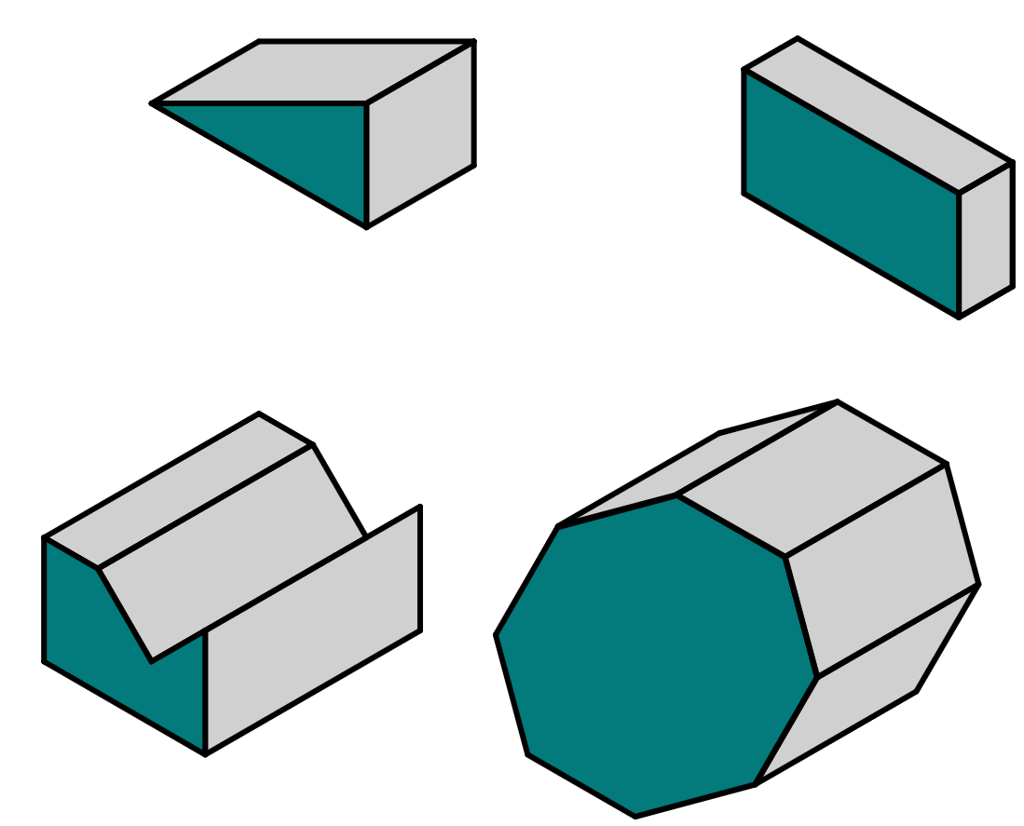

Properties of prisms
Task B: Categorising prisms
1) Place these 3D shapes into the correct row in the table.
triangular prism
quadrilateral prism
pentagonal prism
not a prism
a
b
c
d
e
f
2) On squared paper, sketch the cross sectional polygon for each of these prisms.
3) Write down a suitable name for each prism.
a
b
e
c
d
Mathematics in Education and Industry.
v2.3

